Slide 1
Frail Elders in the Cincinnati Region
Data Examples
Bob Applebaum
Jane Straker

Slide 2
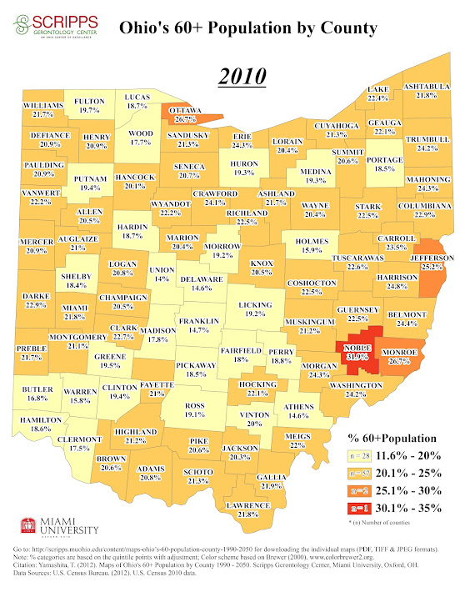

Slide 3
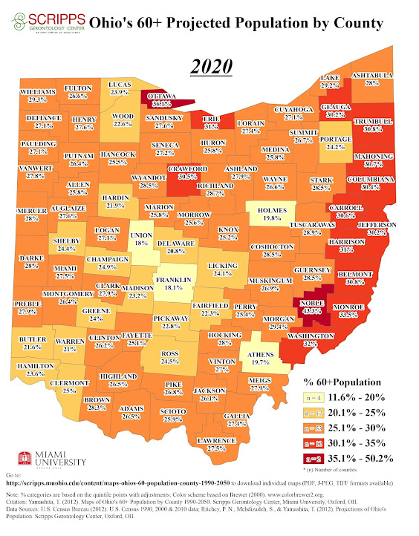

Slide 4
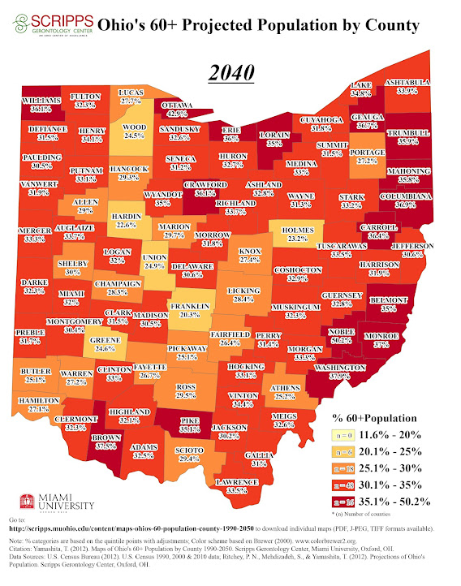

Slide 5
65-84 and 85+
Population 2010

Slide 6
Hamilton Co. Disability Projections 65+ 2010-2030

Slide 7
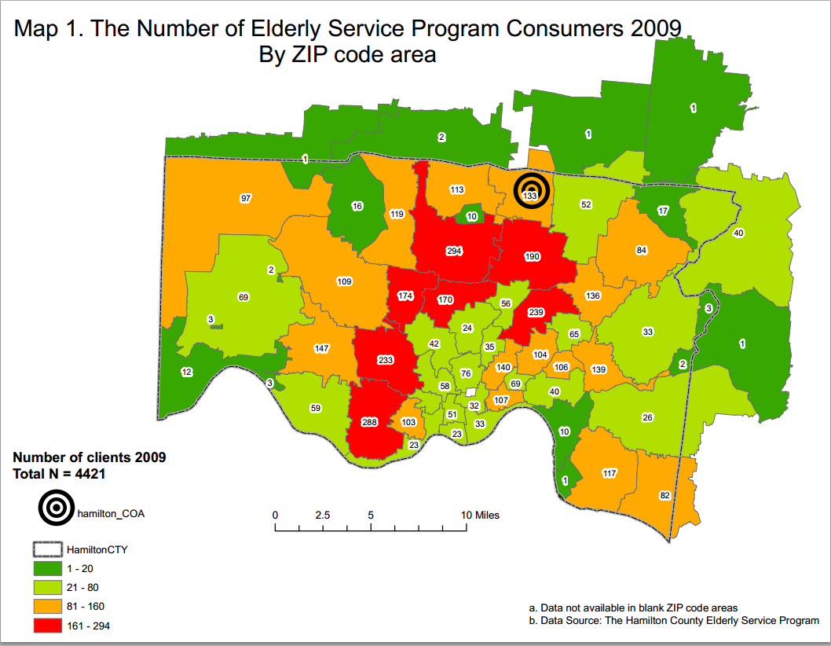
Hamilton Co. ESP

Slide 8
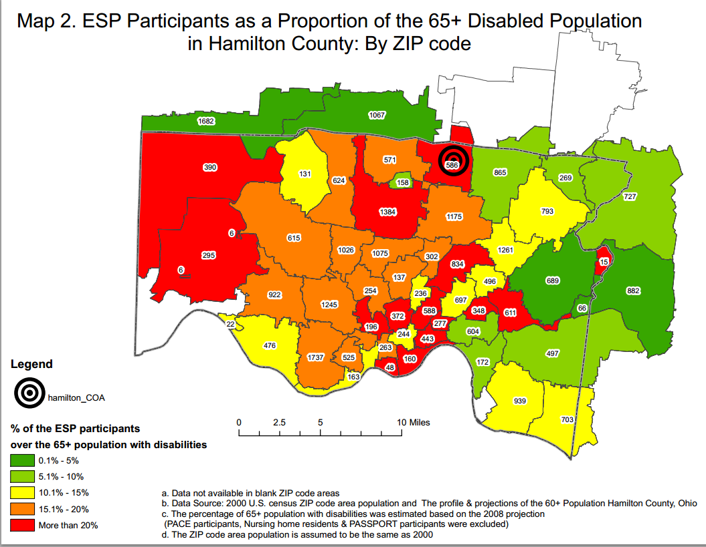
Hamilton Co. ESP

Slide 9
Nursing Home Beds (per 1000 65+)

Slide 10
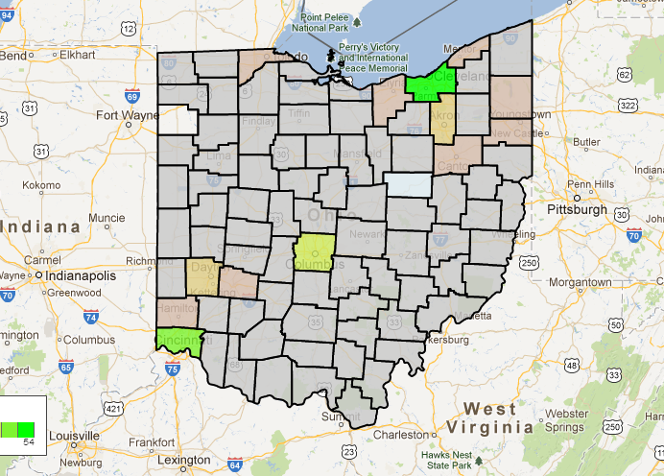
Number of Certified Ohio Nursing Homes www.data.medicare.gov

Slide 11
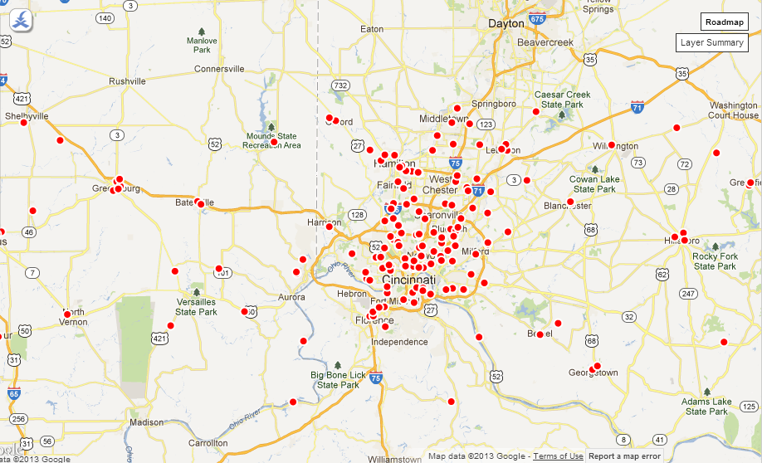
Certified Nursing Homes by Location www.data.Medicare.gov

Slide 12
NF and RCF OH admissions—2011 total 28,291

Slide 13
2011 Admissions per OH NF Bed
Notes:
Statewide avg based on 700+ respondents—247. Hamilton county 185, Butler 247—excluding one facility with over 2,000 admissions.

Slide 14
65+ System Use in Hamilton County
Number | Service Setting
5489 | Nursing Home
2102 | RCF (210 in AL waiver)
1523 | PASSPORT
4994 | ESP (Hamilton Co. Levy)
594 | PACE
14,702 | 32,097 with moderate or severe disability
Notes:
4.6% of RCF residents statewide are under age 65. RCF Hamilton co. census is 2204 (from VR data).
14,702 is 46% of 32,097.

